Slide 1


_______________________________

Slide 2

Object and Color Detection
Supervised by:
Ms. Sadia Ejaz
Group Members:
Aqeela Sultan (Fa17-BCS-072)
Ayesha Nawaz(FA17-BCS-088)
Department of Computer Science
COMSATS University Islamabad, Attock Campus
_______________________________

Slide 3
Outline
Introduction
Related work
Comparison Table
Problem statement
Objectives
Requirement Specification
Methodology
Implementation
Interface
Modern tools
Benefits
Future work
References
_______________________________

Slide 4
Introduction
Object detection is a largely forthcoming scope for detecting object using machine learning methods which are used for social and industrial applications.
Color is a feature that has been heavily exploited in digital image processing, as it is a powerful tool that often facilitates the classification and identification of objects.
Android utility is very easy, handy, portable and fantastic in use.
One can detect the object in an image and also know about the color of the object via text label or voice.
_______________________________

Slide 5
Related Work
Machine learning ensures the decision making process for analysis.
Some approaches:
Artificial Neural Network
Sten Sootla purposed a simple fully connected feed forward artificial neural network with one hidden layer
Dataset CIFAR-10
Accuracy of 38% on unseen data
High computational time
No means successful due to the low accuracy
_______________________________

Slide 6
Related Work
2. Support Vector Machine
Karishma Agrawal kdagrawa, Soumya Shyamasundar sshyamas and Pradheep Shanmugam pshanmug
Dataset CIFAR-10
Classify multiple classes using a technique “One Vs Rest”
10 SVM models one for each class
Original dataset accuracy 41.87%
Preprocessing
- grey scaling (poor result )
- principle components analysis (PCA) (No difference)
- zero component analysis whitening (ZCA whitening) (No difference )
- mirroring (improved accuracy 44.86%)
- adding Gaussian noise to the data (43.305%)
- K-Means clustering ( 55.276%)
_______________________________

Slide 7
Related Work
3. Convolutional Neural Network
Jost Tobias Springenberg, Alexey Dosovitskiy, Thomas Brox and Martin Riedmiller
Pure CNN architecture
Max-pooling replaced by a convolutional layer with increased stride without loss in accuracy
CNN extracts features automatically and predict the object type.
Dataset CIFAR-10
With data augmentation 92.75%
Without data augmentation 90.92%
_______________________________

Slide 8
Comparison Table
Methods | Accuracy | Dataset
Artificial Neural Network (ANN) | 38% | CIFAR-10
Support Vector Machine (SVM) | Original dataset 41.87% Mirroring 44.86% Gaussian noise (43.305%) K-Means clustering ( 55.276%) | CIFAR-10
Convolutional Neural Network (CNN) | With data augmentation 92.75 % Without data augmentation 90.92% | CIFAR-10
Convolutional Neural Network (CNN) (Our work) | With data augmentation 90% | CIFAR-10
_______________________________

Slide 9
Problem Statement
Multiple external devices and mobile applications used for object or color detection.
Low vision user unable to read text labeling on screen.
The main problem if low vision and color blind user wants to recognize an object than how he/she will do it? By downloading multiple android apps for multiple purpose which is not the effective way; resources and a lot effort required.
_______________________________

Slide 10
Objectives
To dispose the need of dedicated gadgets, different wearable devices and also multiple use of android application.
To provide an application to the users to overcome visual disabilities.
To improve each day lives of color blind and people with low vision and hearing.
_______________________________

Slide 11
Requirements Specifications (Functional Requirements )
Input image
Preprocessing
Object Classification
Color Classification
Result
_______________________________

Slide 12
Requirements Specifications (Non-Functional Requirements )
Performance
Capacity
Availability
Maintainability
Efficiency
Flexibility
Usability
_______________________________

Slide 13
Methodology
For betterment of our system, we adopted to implement agile methodology.
This involves delivery of project incrementally rather build and deliver whole project at once.
Object and color detection application is basically android based, we must deliver progress report to supervisor on incremental basis and on that we gradually develop this application.
_______________________________

Slide 14
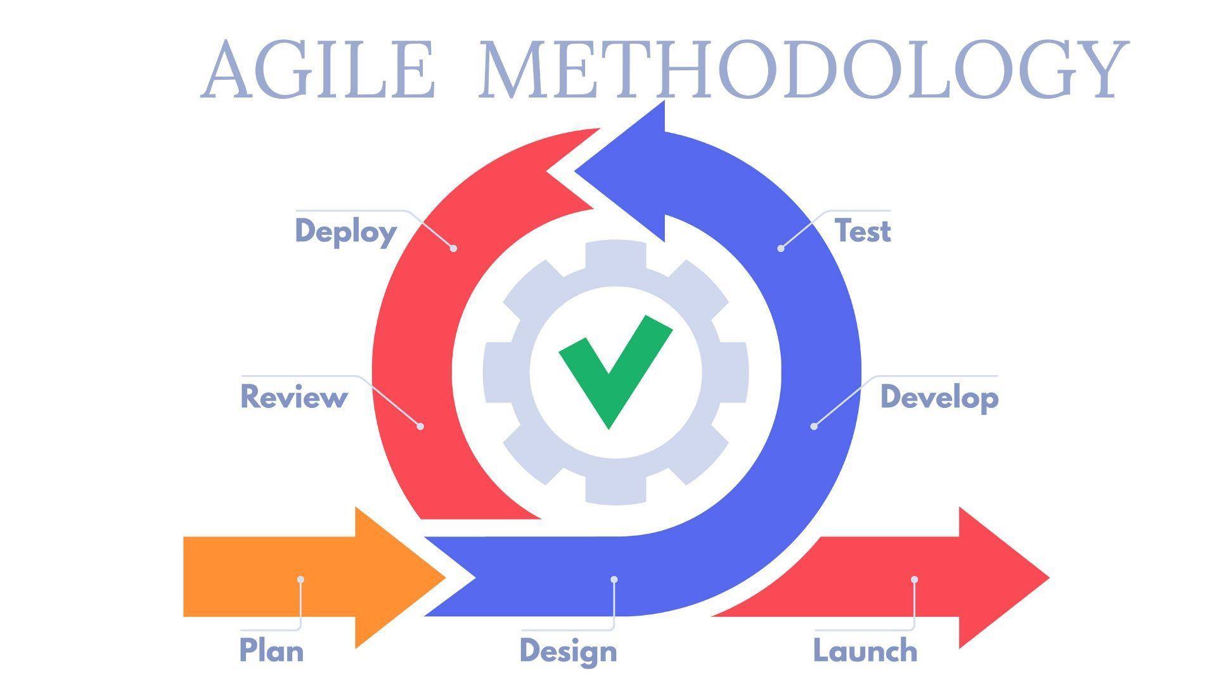
Methodology
_______________________________

Slide 15
Implementation
Dataset
CIFAR-10 (Alex Krizhevsky, Vinod Nair, and Geoffrey Hinton)
Consists of 60,000 (32×32) color images
10 classes
Automobile
Airplane
Bird
Cat
Deer
Dog
Frog
Horse
Ship
Truck
_______________________________

Slide 16
Implementation
Object Classification
Convolutional Neural Network (CNN)
CNN Architecture
Convolutional layers
Dropout layers
Global Average Pooling layer
Softmax
ReLU Activation Function
_______________________________

Slide 17
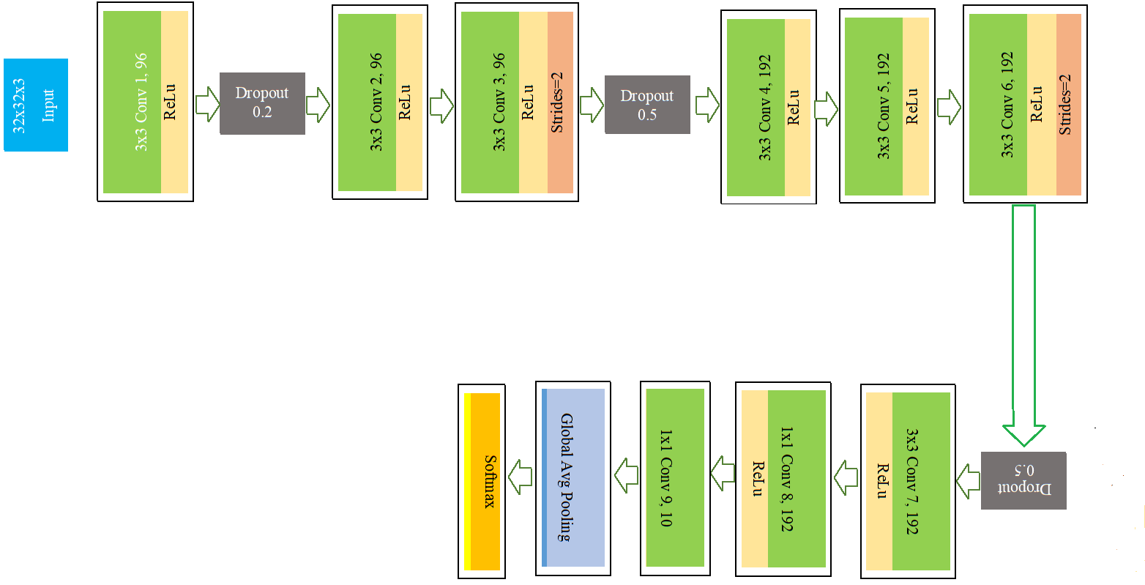
Implementation
CNN Architecture
_______________________________

Slide 18
Implementation
Preprocessing
For training and testing data
Reshape to 4D in floating point
One hot vector encoding
For input image
Image scaling
Data Augmentation
Flipping
Rotating
Shifting
_______________________________

Slide 19
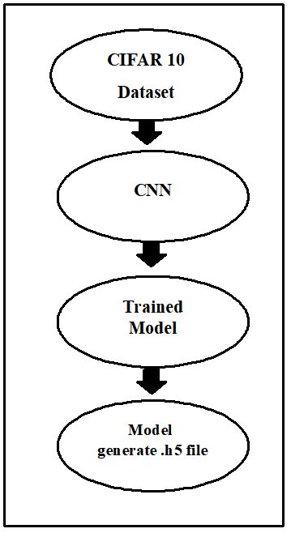
Implementation
Model Train
The training is done in 350 epochs
The model generate .h5 file
Classification Accuracy
For training data
90%
For testing data
87.94%.
_______________________________

Slide 20
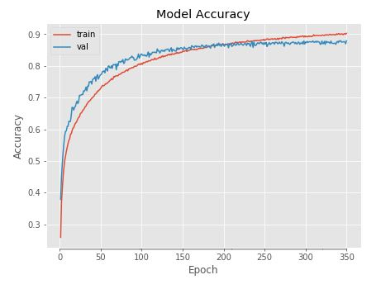
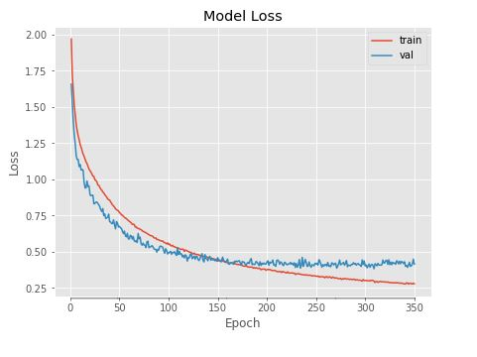
Implementation
Accuracy Graph
Loss Graph
_______________________________

Slide 21
Implementation
Color Classification
Color quantization
K-Means clustering
16 palette
Dominate color of image
Interface
Mobile app using XML and Java language
Connection
Flask framework
HTTP requests and responses
OkHttp
_______________________________

Slide 22
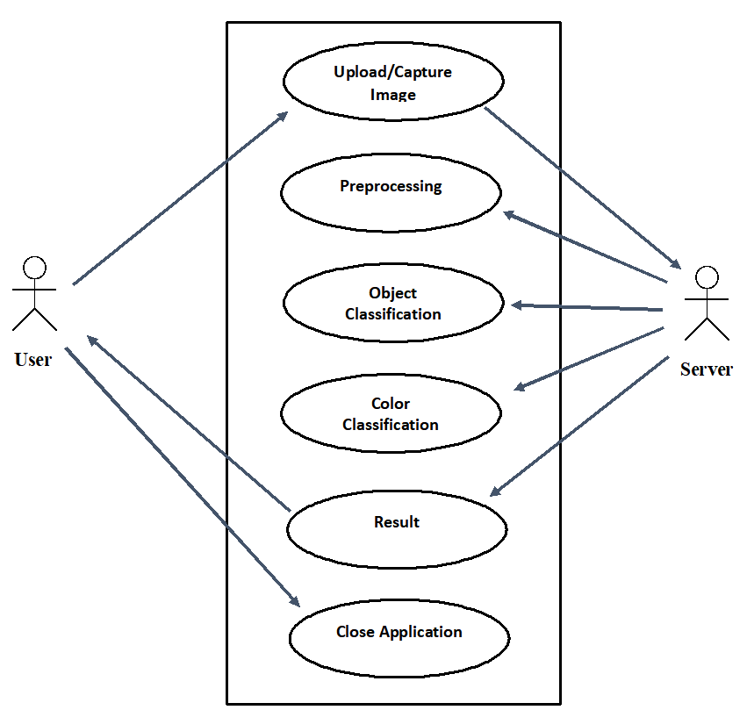
Use Case Diagram
_______________________________

Slide 23
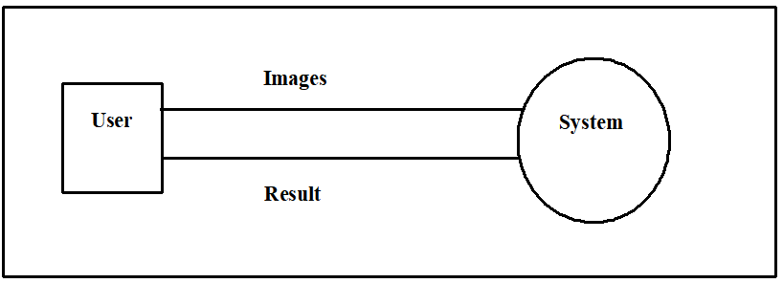
DFD Level 0 (Data flow diagram)
User
_______________________________

Slide 24
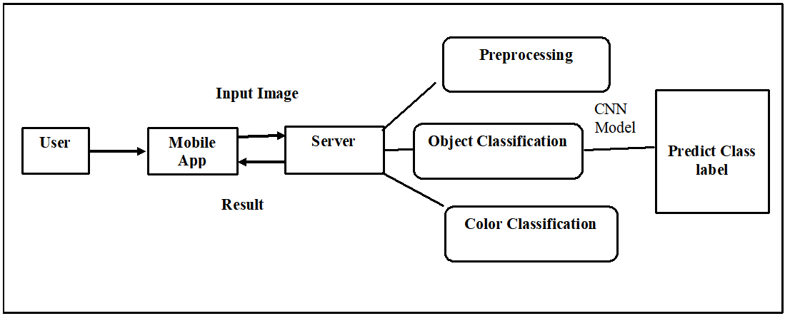
DFD Level 1 (Data flow diagram)
User
_______________________________

Slide 25
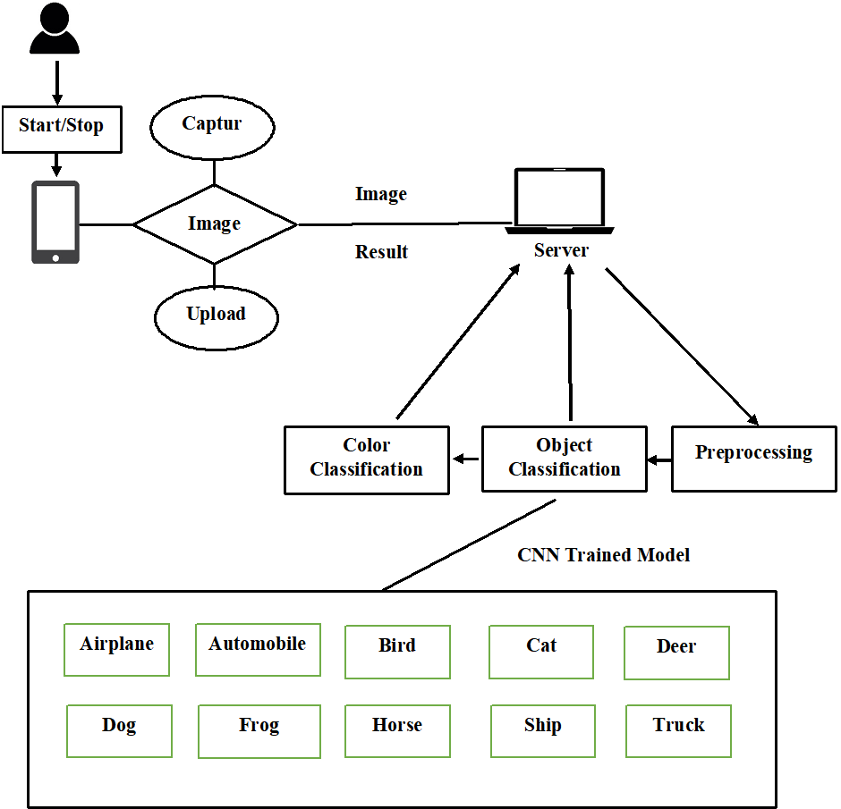
System Architecture
User
_______________________________

Slide 26
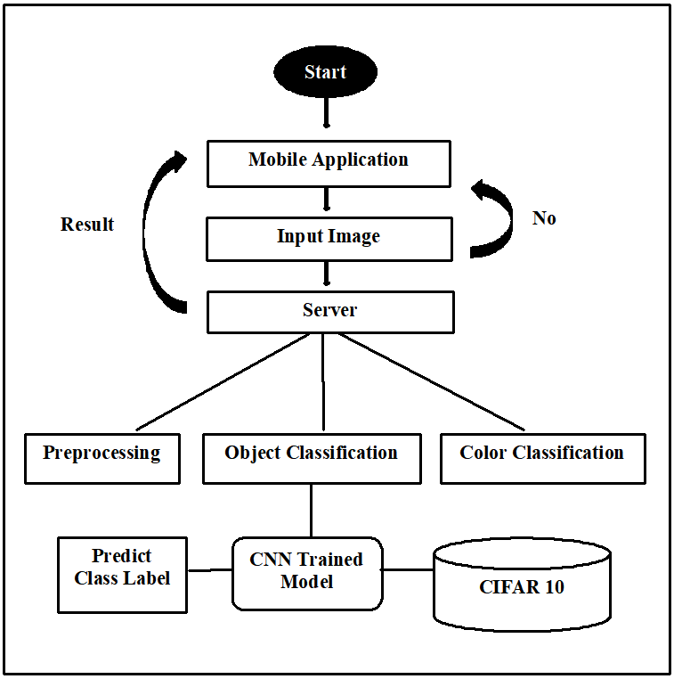
Activity Diagram
_______________________________

Slide 27
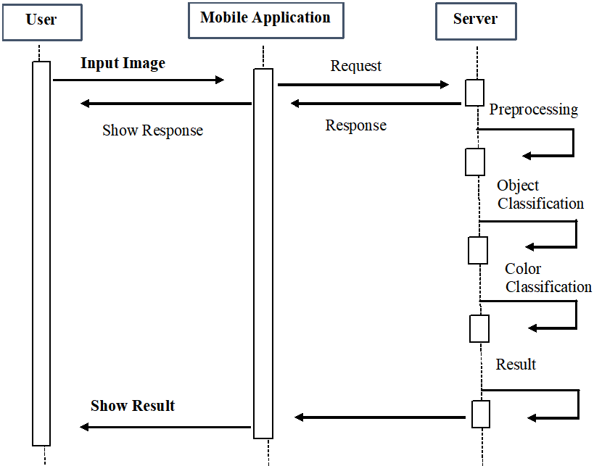
Sequence Diagram
_______________________________

Slide 28
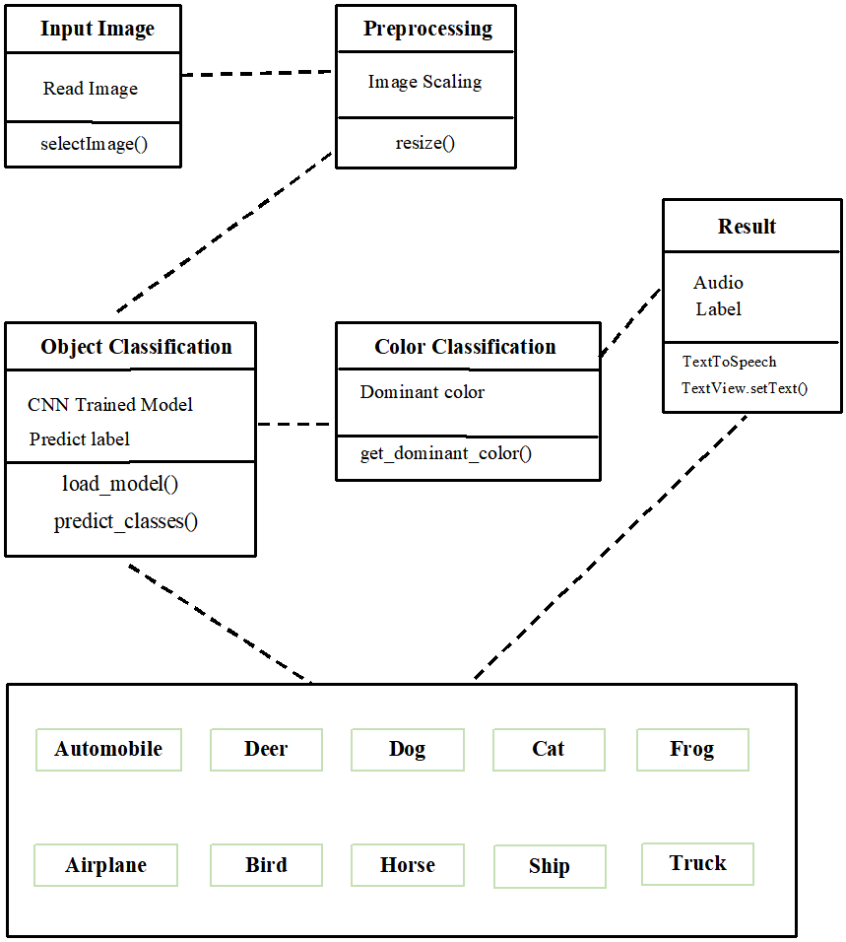
Class Diagram
_______________________________

Slide 29
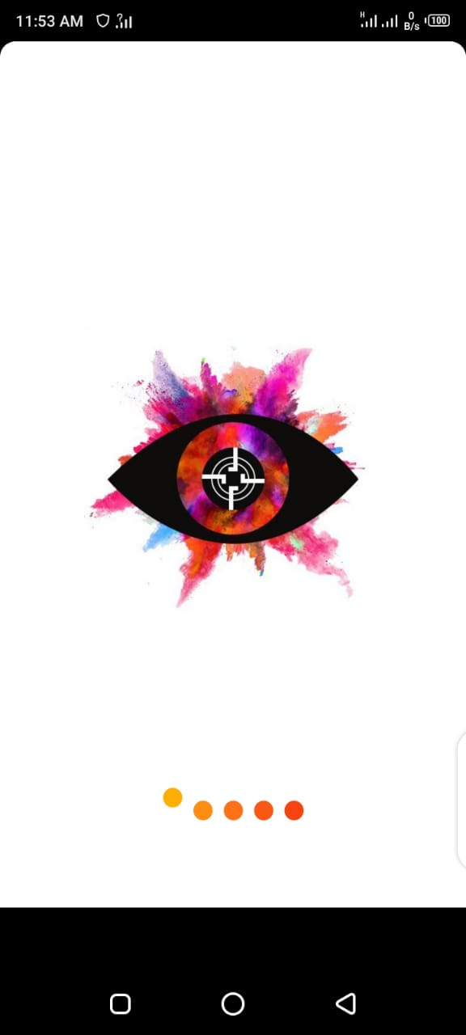
Interface
Splash Screen
_______________________________

Slide 30
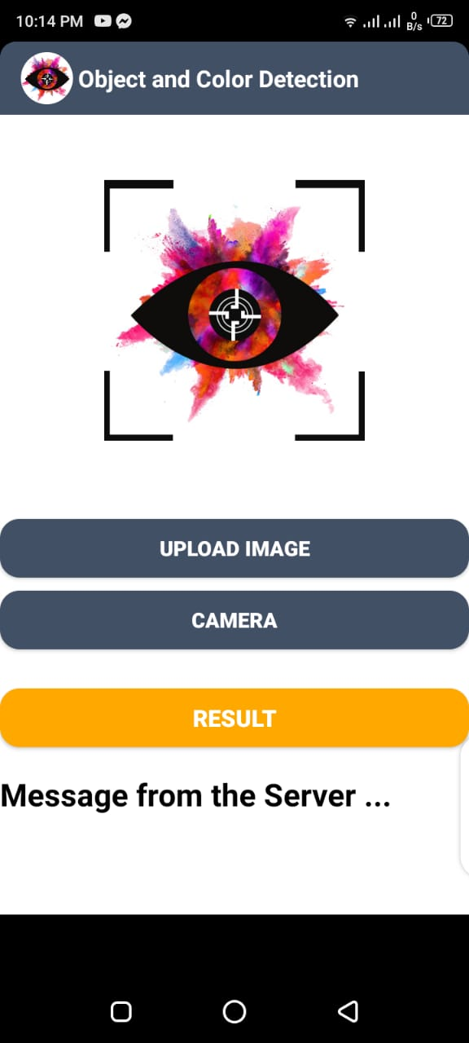
Interface
Main Activity
_______________________________

Slide 31
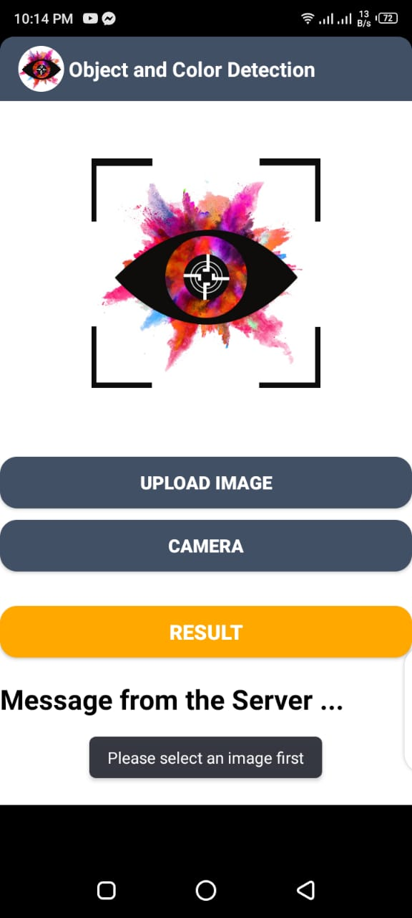
Interface
Without upload image
_______________________________

Slide 32
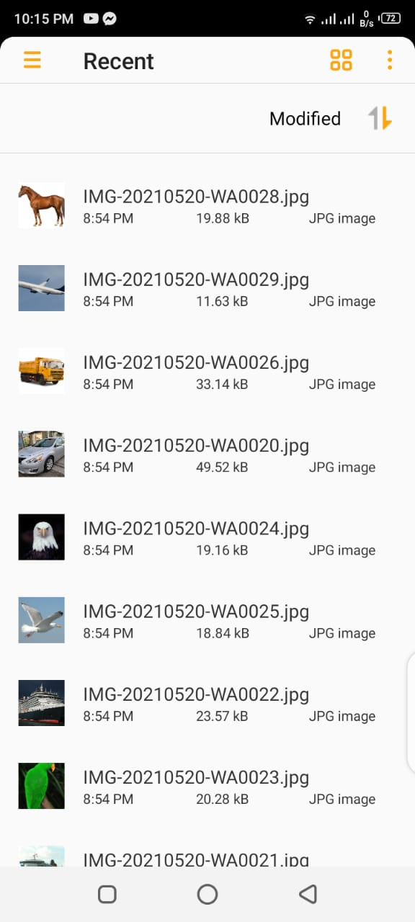
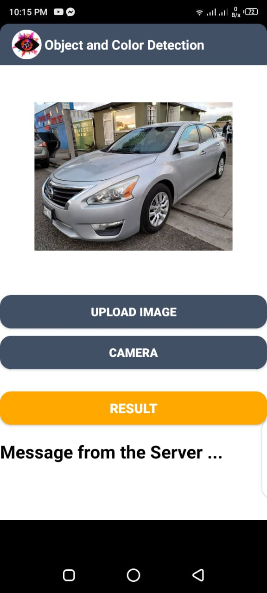
Import Image from Gallery
View
_______________________________

Slide 33
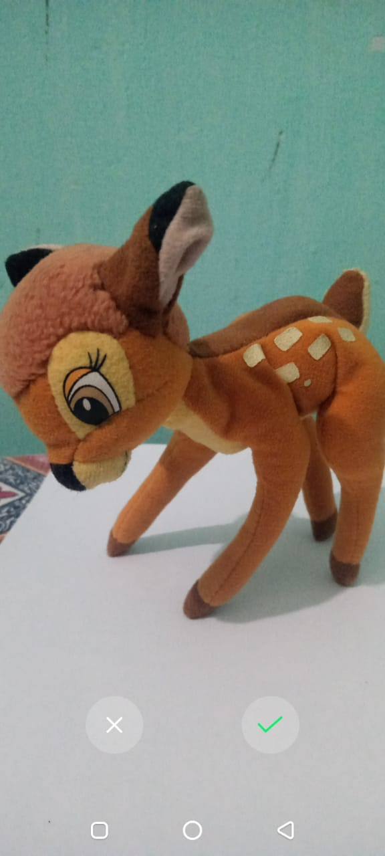
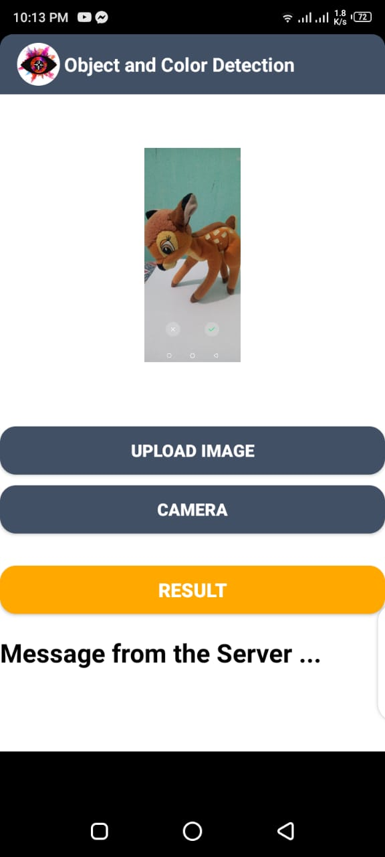
Capture Image
View
_______________________________

Slide 34
Classification Examples
_______________________________

Slide 35
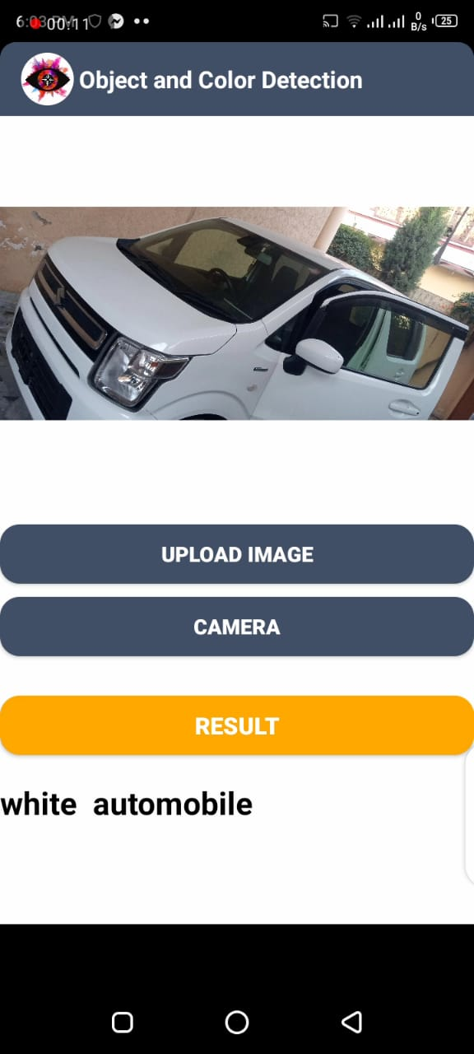
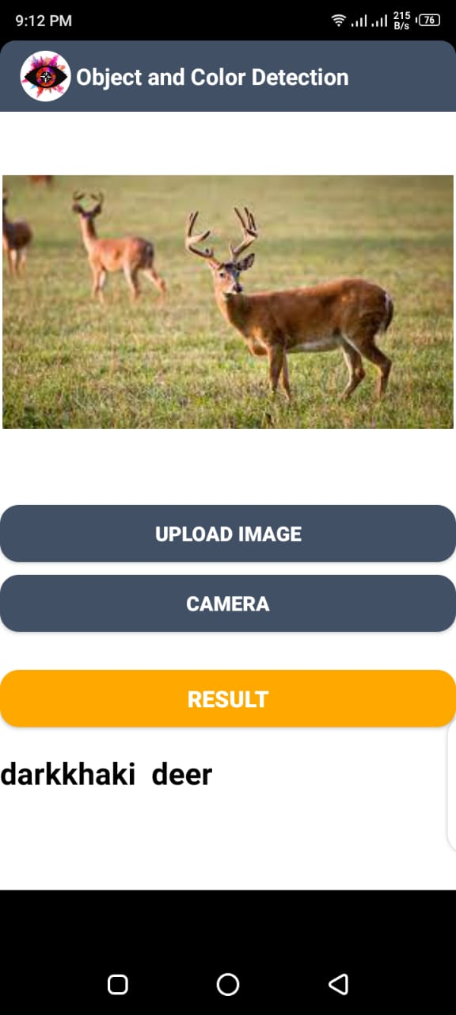
_______________________________

Slide 36
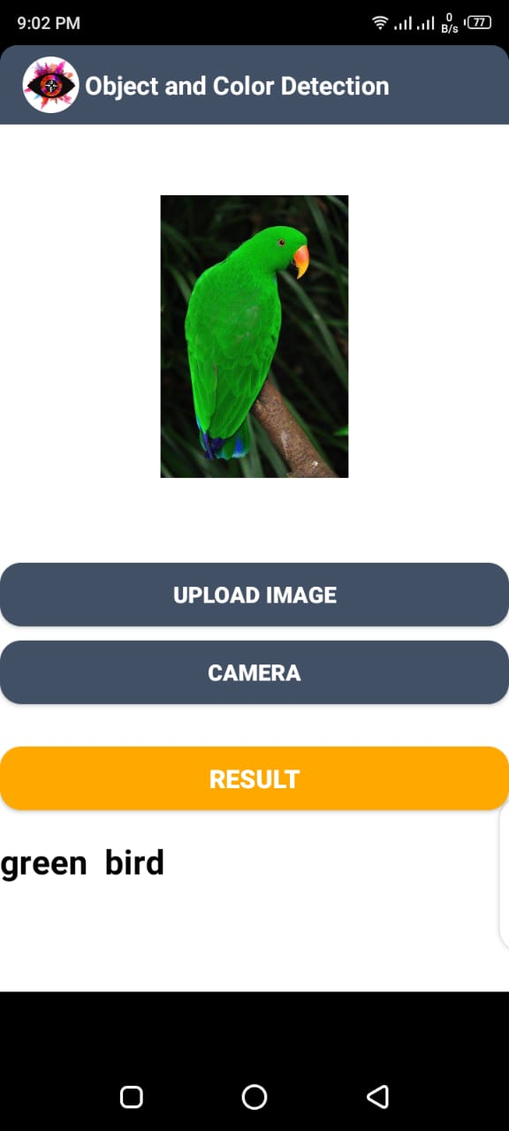
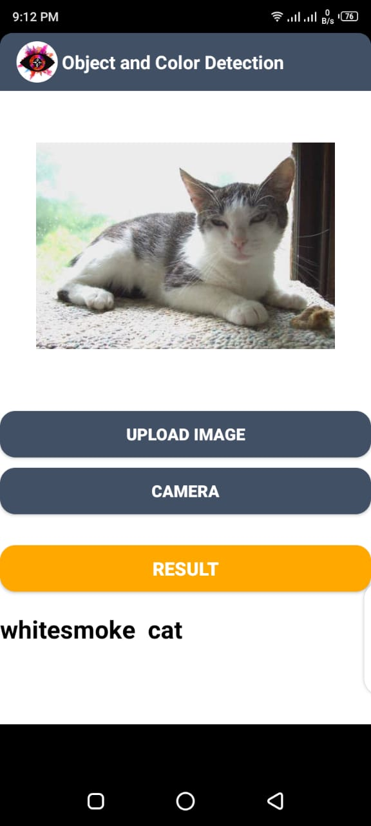
_______________________________

Slide 37
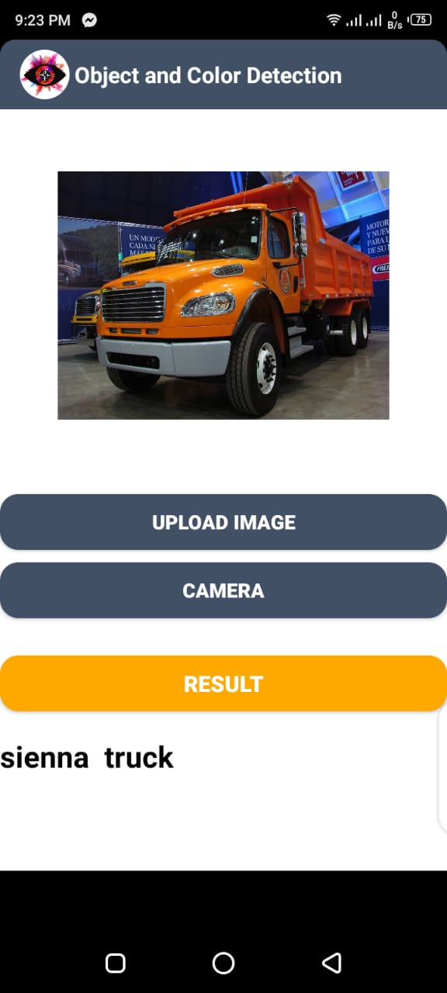
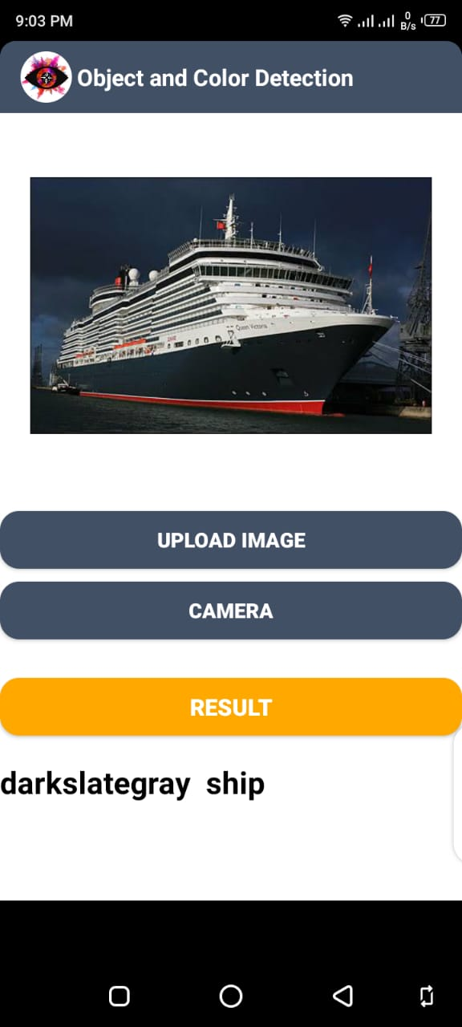
_______________________________

Slide 38
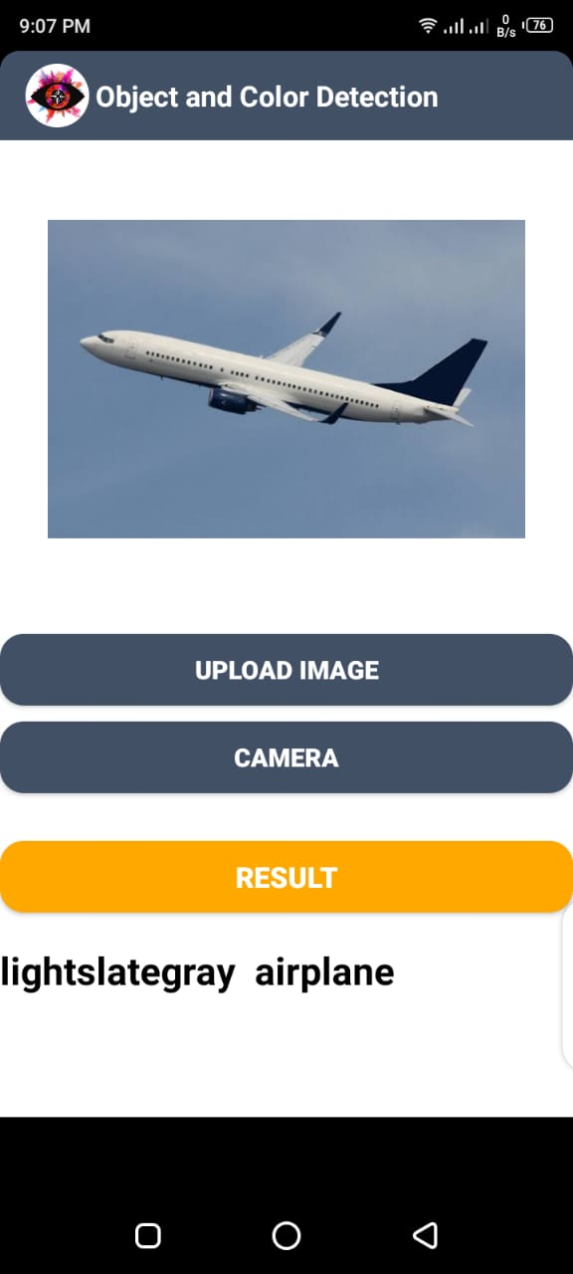
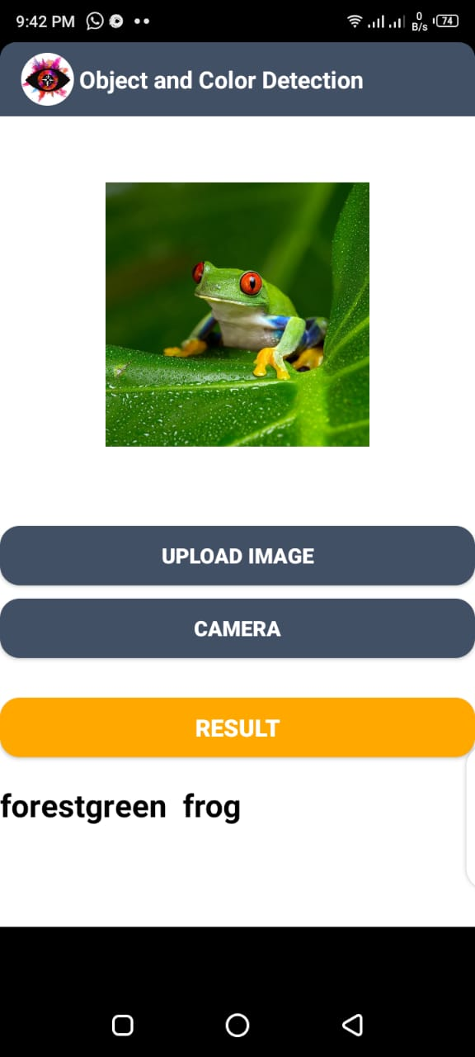
_______________________________

Slide 39
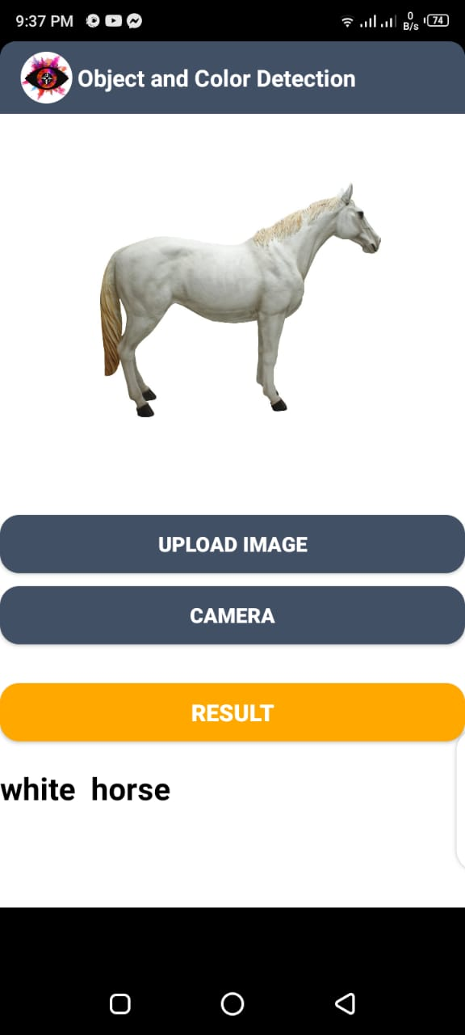
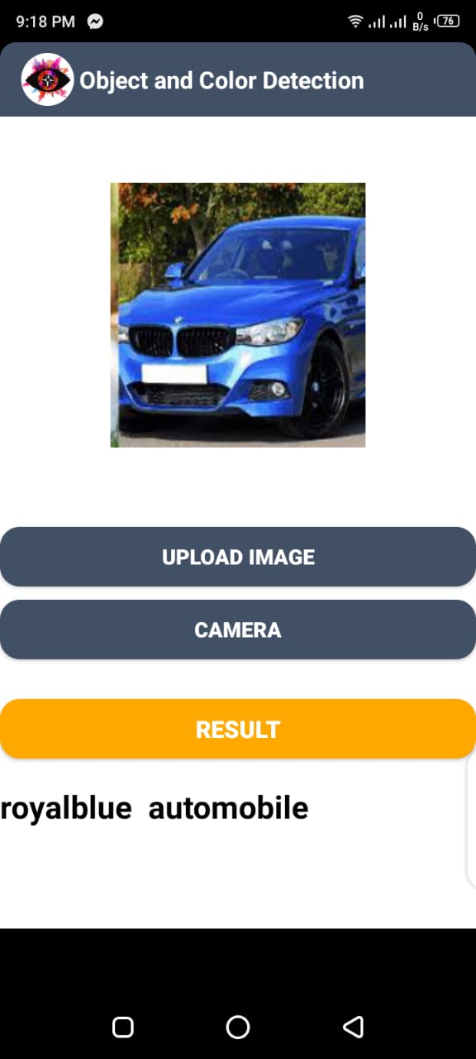
_______________________________

Slide 40
Modern tools
Software Requirements dependence:
ANDROID STUDIO 4.0.1
PYCHARM 2021.1
ANACONDA 2021.11
Jupyter Notebook
Programming language:
Python
Java
XML
Hardware Requirements dependence:
Smart Mobile Phone
Laptop
_______________________________

Slide 41
Benefits
The output is in verbal form to provide users with disabilities with the concept of detected objects and colors.
To save efforts ,resources and money by using this application.
Learning perspective
_______________________________

Slide 42
Future work
Future work will involve the improvement of classification result and overall accuracy.
Multiple object exist and need detection, with more diverse dataset all object can be detected.
_______________________________

Slide 43
References
https://courses.cs.ut.ee/MTAT.03.291/2015_spring/uploads/Main/Artificial%20neural%20network%20for%20image%20classification.pdf
https://www.andrew.cmu.edu/user/kdagrawa/documents/10601report.pdf
https://arxiv.org/pdf/1412.6806.pdf
https://www.cs.toronto.edu/~kriz/cifar.html
https://www.sciencedirect.com/topics/computer-science/android-application#:~:text=Android%20is%20an%20open%2Dsource,customize%20to%20differentiate%20their%20products.
_______________________________

Slide 44
Thank You
_______________________________

